Slide 1
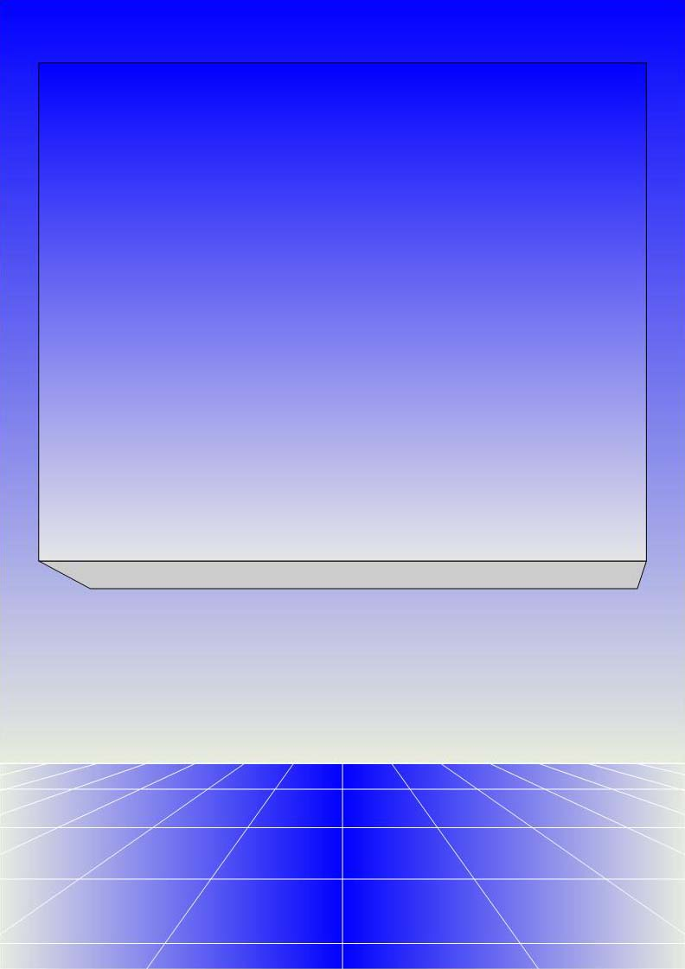
CO2402 - Advanced Programming with C++
Week 18 – Operator Overloading
Gareth Bellaby

Slide 2

Topics
Operator overloading
Friend functions
Overloading the input and output operators
Friend classes

Slide 3
Topic 1
Operator overloading

Slide 4
Overloading
Overloading is the use of the same name for more than one operation or function.
You have already met overloading in the context of function overloading. Function overloading is using the same name for different functions.
Functions are distinguished by the number and types of their arguments.
This lecture looks at overloading operators.
Not the same as virtual functions. With virtual functions, the same name, and number and types of arguments, must be the same. The keyword virtual must be used in the base class. The derived class then defines its own version of the virtual method.

Slide 5
Terminology
Operator. Similar to operators in mathematics. An operator operates on function, class or mathematical value, e.g. + - / * % [ ] == = !
Unary operators take one operand, e.g.
-a (negative).
Binary operators take two operands, e.g.
a = b (assignment)

Slide 6
Operator Overloading
All operators can be considered to be functions, e g. a = b + c;
It is possible to write new versions of the operators so that they work on other data types.
Specifically you can write operators for your own classes.
When an operator is overloaded, it takes on an additional meaning relative to a certain class.
It still retains its old meanings.

Slide 7
Operator Overloading
A member operator function takes this general form:
  return-type class-name::operator#(arg-list)
  {
  // definition
  }
operator is a keyword.
# is the place holder
When used, substitute an operator for the #.

Slide 8
Operator overloading
The operator needs to be one of the standard C++ operators.
The operand is a an object (an instance) of the class we are currently defining.
Easiest to show using an example.

Slide 9
TwoInts class
class CTwoInts
{
private:
int mX;
int mY;
public:
CTwoInts( ) { };
CTwoInts( int x, int y ) : mX( x ), mY( y ) { } ;
void Display();
CTwoInts operator = ( CTwoInts );
CTwoInts operator + ( CTwoInts );
CTwoInts operator * ( CTwoInts );
};

Slide 10
Assignment
CTwoInts CTwoInts::operator =
( CTwoInts operand )
{
mX = operand.mX;
mY = operand.mY;
return *this;
}
Assignment
For later: look at deep and shallow copying because there are some pitfalls when implementing assignment.

Slide 11
The this pointer
When a member function is called it is automatically given a pointer to the invoking object.
This pointer is called this.
For later: a static member function does not have a this pointer.

Slide 12
The this pointer
These two methods are identical:
void CTwoInts::Display( )
{
cout << mX << " " << mY;
}
void CTwoInts::Display( )
{
cout << this->mX << " " << this->mY;;
}

Slide 13
Addition
CTwoInts CTwoInts::operator +
( CTwoInts operand )
{
mX = mX + operand.mX;
mY = mY + operand.mY;
return *this;
}

Slide 14
Multiplication
CTwoInts CTwoInts::operator *
( CTwoInts operand )
{
mX = mX * operand.mX;
mY = mY * operand.mY;
return *this;
}

Slide 15
In operation
int main()
{
CTwoInts* a = new CTwoInts;
CTwoInts* b = new CTwoInts( 3, 8 );
CTwoInts* c = new CTwoInts( 2, 4 );
CTwoInts* d = new CTwoInts( 5, 7 );
*a = *b; // deferencing a->Display( );
*a = (*b) * (*c) + (*d); // dereferencing
// (3 * 2) + 5, (8 * 4) + 7
a->Display( ); // 11 39
}

Slide 16
Operators
The compiler knows which version of the operator to use in the same way as with any function. It looks at the data type of the associated variables.
The two data types are integers so the integer assignment function is called.
int a;
a = 4;
The data types are CTwoInts so the class assignment method is called.
CTwoInts* a = new CTwoInts( 1, 6 );
CTwoInts* b = new CTwoInts( 2, 5 );
*a = *b; // deferencing

Slide 17
Operator rules
One operator (at least) must be a class type
The following operators can only be overloaded as a member of a class
    =, [ ], ->, ( )
You cannot create new operators, only overload the existing ones.
You cannot change the number of arguments taken by the operator.
Cannot change the precedence of the operator.
Some operators cannot be overloaded:
. (dot operator), ::, sizeof, ?, .*
Operator cannot have default arguments

Slide 18
Topic 2
Friend functions

Slide 19
Friend functions
Need friend functions in order to overloading the I/O operators.
Friend functions are nonmember functions that have all of the privileges of member functions.
Label the function a friend function in the class definition.
However, the definition is provided by the declaring class.
So the declaring class actually retains control.

Slide 20
Topic 3
Overloading the input and output operators

Slide 21
Overloading << and >>
An obvious step. Shown how you can overload the other operators such as +, =.
<< works with output streams.
>> works with input streams.
For << or >> to work the first operand must be cin or cout (or other appropriate I/O stream).
<< and >> are binary operators.

Slide 22
class declaration
class CTwoInts
{
private:
int mX;
int mY;
public:
friend ostream &operator << ( ostream& outputStream, CTwoInts operand );
};

Slide 23
Friend functions
Use the keyword friend.
Formally the method is a member of the cout or cin class.
Declared in the current class.
A class declares that the a method belonging to the another class is its friend.
It also defines the method.
It has to be done this way. Otherwise classes such as cin and cout (or whatever) would have to know about all of the classes that are going to use them.

Slide 24
<< definition
ostream &operator <<
( ostream& outputStream, CTwoInts operand )
{
cout << "( " << operand.mX << " , ";
cout << operand.mY << " ) ";
return outputStream;
}

Slide 25
In operation
int main()
{
CTwoInts* a = new CTwoInts;
CTwoInts* b = new CTwoInts( 3, 8 );
CTwoInts* c = new CTwoInts( 2, 4 );
CTwoInts* d = new CTwoInts( 5, 7 );
*a = (*b) * (*c) + (*d); // dereferencing
// (3 * 2) + 5, (8 * 4) + 7
cout << *a << *b << *c << *d;
}

Slide 26
Discussion
Use of the friend keyword.
It is up to you to decide exactly what it is that << outputs.

Slide 27
Returning the stream
You can see that the method returns the input stream. In order to understand why this happens we need to consider how the output operator works.
int number = 7;
cout << "the value is " << number;

Slide 28
Returning the stream
The target stream is given at the beginning of the line. This is followed by one or more << operators. Each operator has one associated operand.
The compiler evaluates the line in sequence: it performs a sequence of commands.
First evaluation is:
cout << "the rain in "

Slide 29
Returning the stream
We would want the second evaluation to be
cout << country
The only way this would occur is if the first evaluation returned cout. If it didn't we would be left with just
<< country
Final evaluation:
cout;
No more << operators. Process ends.

Slide 30
Evaluating the line
cout << "the value is " << number;
Evaluate first part
cout << "the value is "
Return cout
Evaluate next part
cout << number
Return cout
Evaluate last part
cout;
End

Slide 31
I/O operators
Safest to set the output object to const. It does not get changed and do not want an output method to be able to change the object.
The operator of >> is analogous to <<.

Slide 32
Topic 4
Friend classes

Slide 33
Friend classes
The other class is a friend. I have granted it full access to my private data and methods.
It is a one-way privilege.

Slide 34
Friend Classes
One class can be a friend of another class.
The friend class and all of its member functions have access to the private members defined within the other class.

Slide 35
Friend Classes
You can also have a friend class.
Use the two keywords "friend class" in order to grant this.
Declared in the granting class.
Allows another class access to the private data members and methods of the granting class.

Slide 36
Granting class
class CGrantingClass
{
private:
int mData;
public:
CGrantingClass( int data ): mData( data ) { /* empty body */ }
friend class CTest;
};

Slide 37
Test class
class CTest
{
private:
int mStore;
public:
CTest( int store) : mStore( store) { /* empty body */ }
void Display( CGrantingClass* myFriend ) { cout << mStore << " " << myFriend->mData << endl; }
};

Slide 38
In Use
void MyMain( )
{
CGrantingClass* granting = new CGrantingClass( 5 );
CTest* test = new CTest( 7 );
test->Display( granting ); // outputs: 7 5
}

